Slide 1


MAJOR LEAGUE BASEBALL: GAME ATTENDANCE
ANDRÉE WERNER
METIS 2018
Notes:
Seems like baseball is in the air, from the investigation yesterday to google’s doodle today. In this project, i’m looking at a predictive model for major league baseball game attendance. I used baseball reference.com as my site to scrape from.

Slide 2
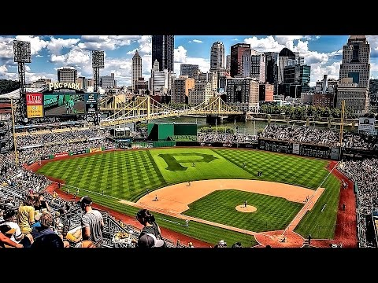
OPPORTUNITY
Revenue Increase
$3.5B in 2001 to $10B in 2017
Ticket Revenue: $3B in 2017
Dynamic Ticket Pricing
Game-to-Game Variation
Few Season Ticket Holders
Notes:
the ticket sales revenue for all MLB teams combined was $3 billion in 2017, 30% of total league revenue was generated through ticket sales in that same year.
the MLB, of all major american sports franchises, has been quick to spot an issue (static ticket pricing). scalpers and resellers make high profit on mispricing of tickets at the last minute.
They could make more for hot games, and fill empty seats more effectively for not so hot ones if they did dynamic ticket pricing. Why?
Baseball has very high game to game variation in terms of rotating starting pitchers every 5 days, which causes fans to pick and choose specific matchups
I want to look at predicting game attendance in order to look into this potential pricing issue in the future.

Slide 3
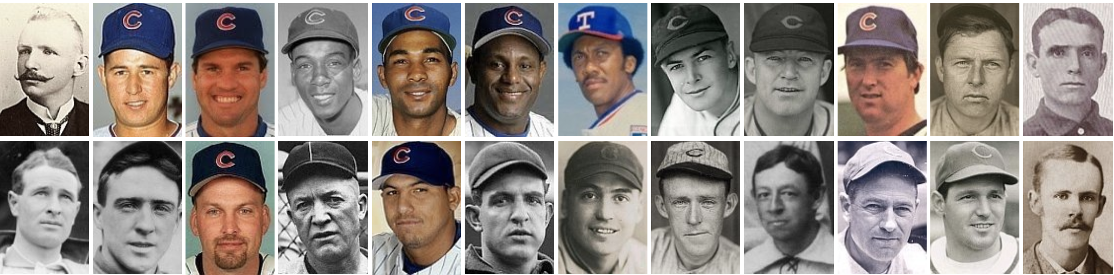


MLB INFORMATION
30 teams in MLB
2 leagues
(3 divisions each)
Years: 2000 - 2017
THE DATA
Game level by team
Team level by season
Stadium data
43,000 samples
SCRAPING TOOL
BeautifulSoup
Reformat:
• match rest of deck template
• black background behind the third box
• spacing and font should match across the board

Slide 4
REGRESSION MODEL PIPELINE
CLEAN DATA
Add features:
Win %
top player stat
Dummy variables:
Double Header
Day vs. Night
Filter to home game by team
DEFINE TARGET
&
FEATURES
Target: Attendance
Features: 24 initial, 16 final
OBSERVE
&
FEATURE ENGINEER
linear relationship between
features and target
SCRAPE DATA
Organized by team & year
EVALUATE MODEL
Improve how the model predicts the target and try to reduce RMSE

Slide 5
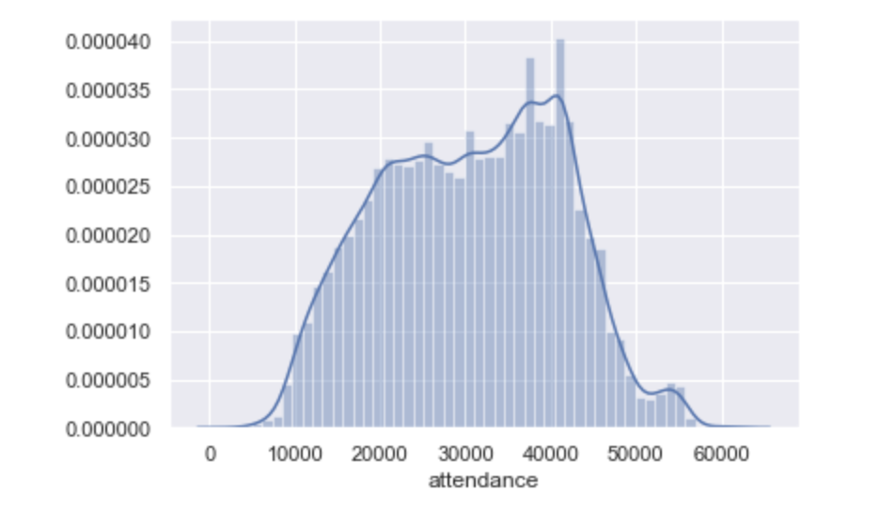
TARGET
y = attendance as proxy for ticket sales
Notes:
normal shape gave me a good idea to keep with a linear model to start

Slide 6
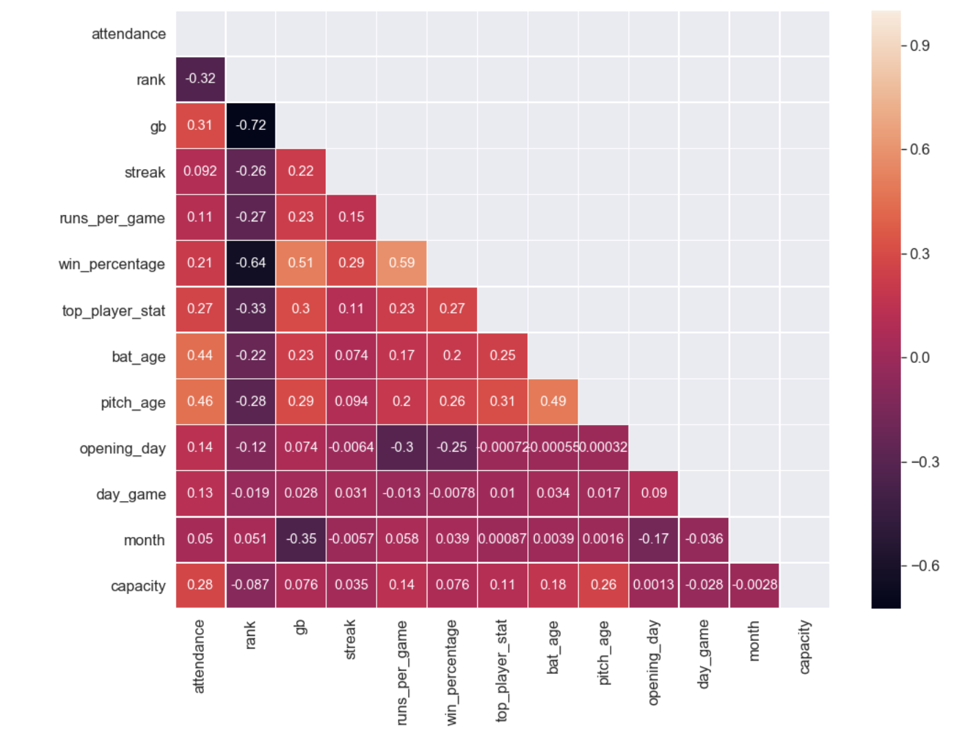
FEATURE BREAKDOWN
batters’ average age
pitchers’ average age
win percentage
top player statistic
GB (“games behind”)
stadium capacity
winning streak
opening day
day vs. night game
day of week
month
runs per game
divisional rank
team
stadium
opponent
Notes:
eliminated features that were redundant to (reduce collinearity)
there are many features here but let’s keep an eye on the first few
looked at some interactions (like win percentage and batters average age) using polynomial features but this didn’t change r^2 significantly

Slide 7
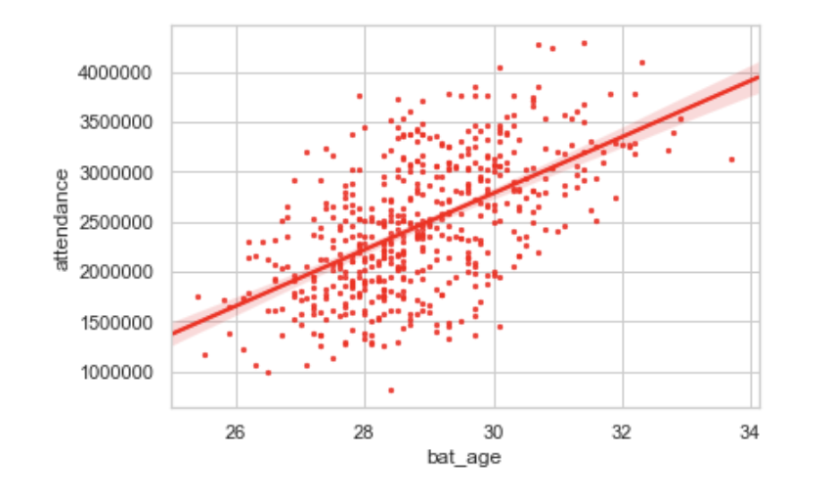
Increase in average age of team’s batters: increase in attendance
Notes:
we see a positive correlation between average age of team’s batters and attendance
at first surprising to me, but makes sense looking at baseball players peaking at ages 28-30, fans following their favorite player, across seasons

Slide 8
TRAIN - TEST - RINSE AND REPEAT
HOLDOUT SET: 20%
VALIDATION SET: 20%
TRAINING SET: 80%
LINEAR
RIDGE
POLYNOMIAL
Notes:
not much overfitting in the model but i tried some other models in case.
ridge and lasso for feature scaling
polynomial for interactions between features

Slide 9
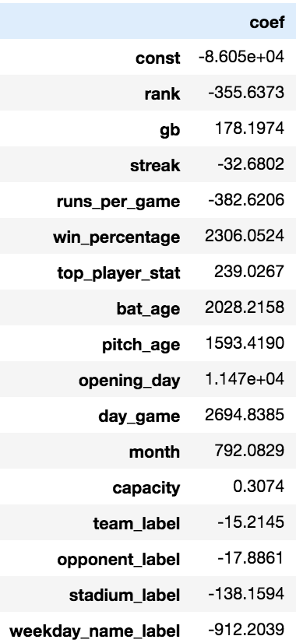
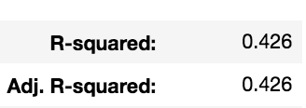
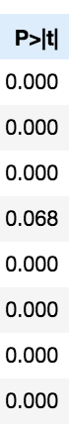
A linear model is okay at predicting target in initial OLS pass
Some standout features from coefficients perspective:
batters’ average age
pitchers’ average age
opening day
Notes:
Mention residuals plot about symmetric about 0 so little need for
non-linearity or heteroskedascitiy didn’t appear to be issues from my residuals
wary of opening day because very high binary variable effect
feature scaled

Slide 10
5-FOLD CROSS-VALIDATION
r²
RMSE
8052.3842
0.426
IF WE CARE ABOUT TICKETS SOLD (SEATS FILLED), RMSE MIGHT BE SOMETHING THAT’S ESPECIALLY USEFUL
Across the models, r² hovers around the mean value after cross validation
Notes:
to validate, i looked at k-fold and saw that the r^2 didn’t go off mean baseline
take a look at RMSE, good proxy for the area of interest which is seats sold
keep this in mind as we continue
still in hot pursuit of improving my score
CLICK

Slide 11
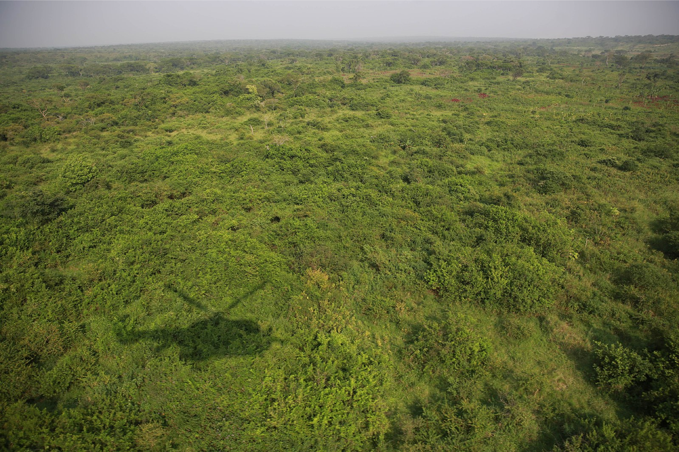
TREES ARE ALWAYS GOOD
Notes:
i thought about trees.
tree models i mean
this will automatically take care of interaction features that

Slide 12
RANDOM FOREST REGRESSOR MODEL
r²
RMSE
0.753
5272.7176
r² went up by .3 and RMSE went down by ~3000
RMSE decrease is good
Notes:
also looked at gradient boost regressor but the change from rfr was more significant
here we give up some explainability for higher predictive accuracy. When we’re talking about absolute tickets sold, predictive power becomes more important
as we’ve discussed these models can sacrifice interpretability, esp. from coefficients effect. if we look at feature importance, however, CLICK

Slide 13
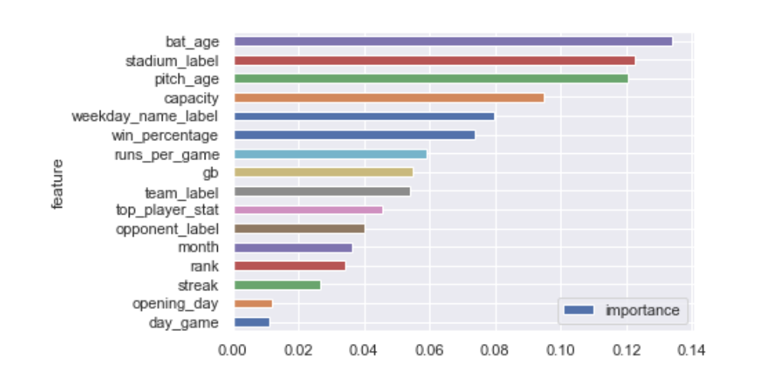
RELATIVE FEATURE IMPORTANCE
KEY INFLUENCERS
batters’ average age
stadium
pitchers’ average age
Notes:
As we’ve discussed these models can sacrifice interpretability, esp. from coefficients effect. if we look at feature importance, however, we can get a slightly clearer picture of what’s going on here btw my features and target and it looks like the few from before still stand out
CLICK

Slide 14
FUTURE EXPLORATION
WEATHER DATA
CONCESSIONS SALES
Notes:
layer on weather data
help predict how and concessions stands at stadiums can harness more or fewer resrouces

Slide 15
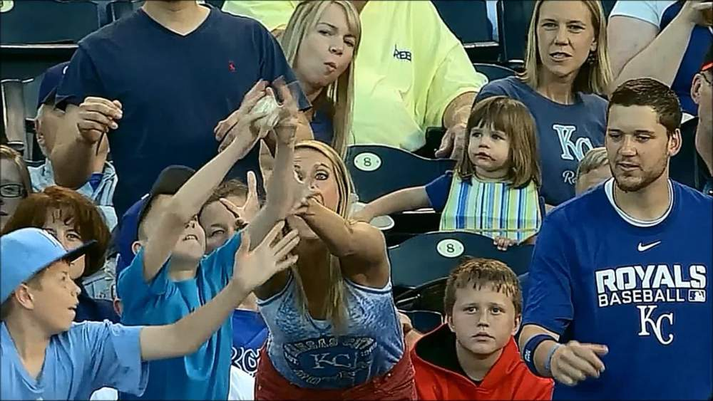
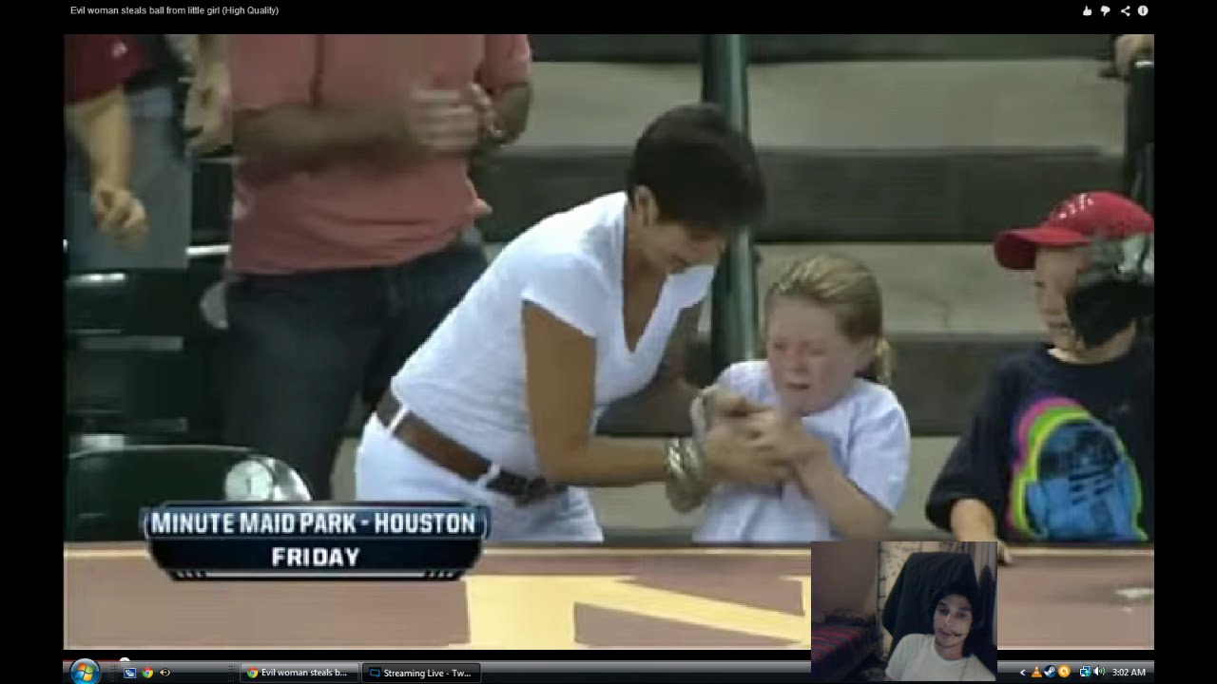
….Stealing balls from kids ??
THANKS!!
Notes:
baseball fans are wild.
The ones that actually make it to the stadium are very passionate,
I wanted to predict how people like this will sho up to live games.
In other words there’s a lot of opportunity in

